Slide 1
Building an infrastructure-as-code pipeline
Jaime Omar Montero Aguilar
2021

Slide 2

Who I am?
details:
first_name: Omar
last_name: Montero
title: Site Reliability Engineer
profile: "Site Reliability Engineer with 5+ years of hands-on experience on areas of Vulnerability Scanning, Certificate Management, Password Policy Management, Data Analysis of security monitoring outputs, coordination of Remediation Patching, and other daily Security and Compliance efforts. I have software development experience spanning Solution Architecture, DevOps, Security,Site Reliability, A/B Testing, BlueGreen, Chaos Engineer, web development and hands - on application troubleshooting in enterprise and Cloud Amazon Web Services (AWS) for multiple production workloads."
contact:
- text: omar.mx.1990@gmail.com
url: mailto:omar.mx.1990@gmail.com
icon: email

Slide 3
What is Infrastructure as Code (IaC)?
IAC Benefits
Infrastructure as Code (IaC) is the managing and provisioning of infrastructure through code instead of through manual processes.
With IaC, configuration files are created that contain your infrastructure specifications, which makes it easier to edit and distribute configurations. It also ensures that you provision the same environment every time.
IaC can help your organization manage IT infrastructure needs while also improving consistency and reducing errors and manual configuration.
Benefits:
Cost reduction
Increase in speed of deployments
Reduce errors
Improve infrastructure consistency
Eliminate configuration drift

Slide 4

Where do you start?

Slide 5
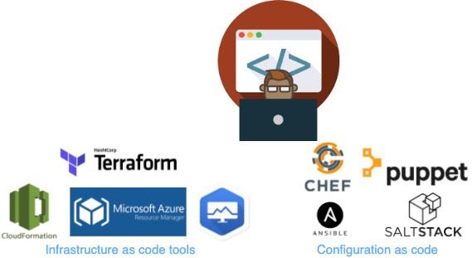
Use your favorite programming language to provision Infrastructure as Code

Slide 6
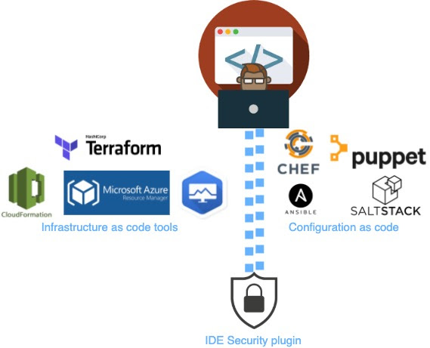




Vulnerabilities in IAC
A scanner follows an automated process to scan different elements of a device, application, or network for possible security flaws. To ensure everything is easy-breezy, you need to perform regular scans.
Benefits:
Increased Security
Reputational safety
Compliance supervision

Slide 7
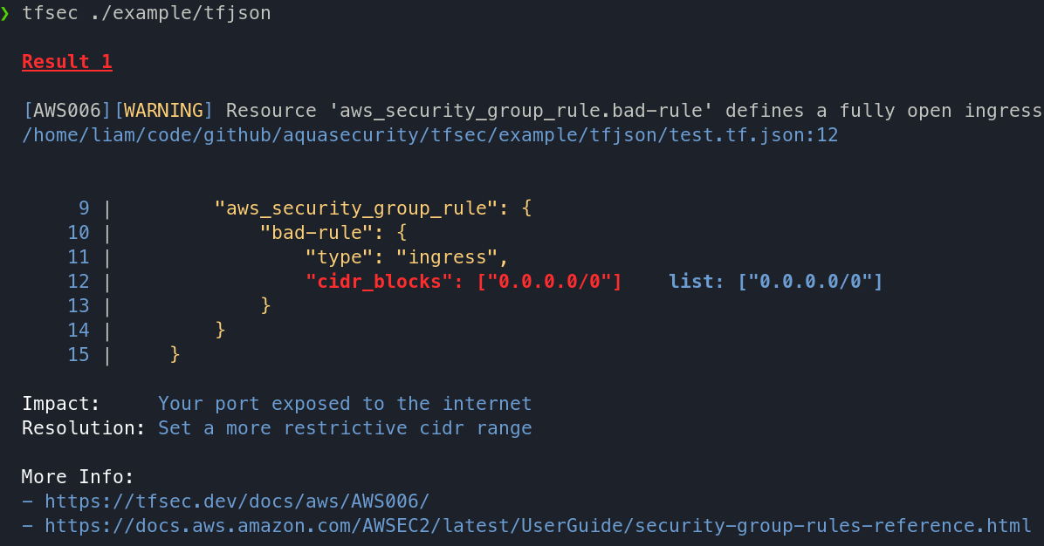
Example Output
Therefore, failing to follow the best practices could lead to security loopholes like compromised cloud environments, leading to issues like:
Benefits:
Network exposures
Drifting configuration
Unauthorized privileged escalations
Compliance violations

Slide 8
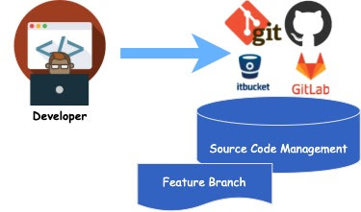
Source code management
Source code management (SCM) is used to track modifications to a source code repository. SCM tracks a running history of changes to a code base and helps resolve conflicts when merging updates from multiple contributors. SCM is also synonymous with Version control.
Source code management best practices
Commit often
Ensure you're working from latest version
Make detailed notes
Review changes before committing
Use Branches

Slide 9
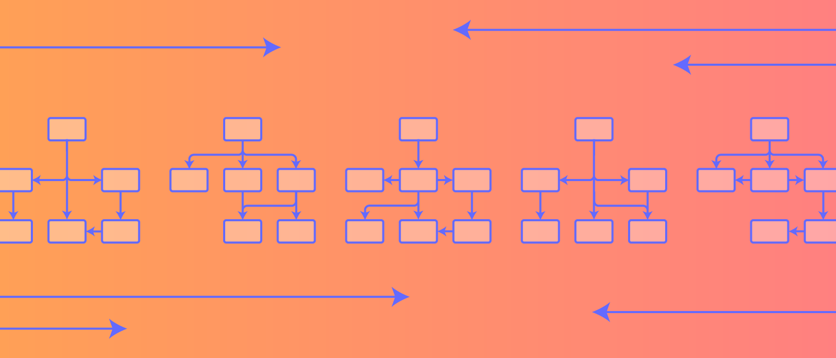
Design a flowchart

Slide 10
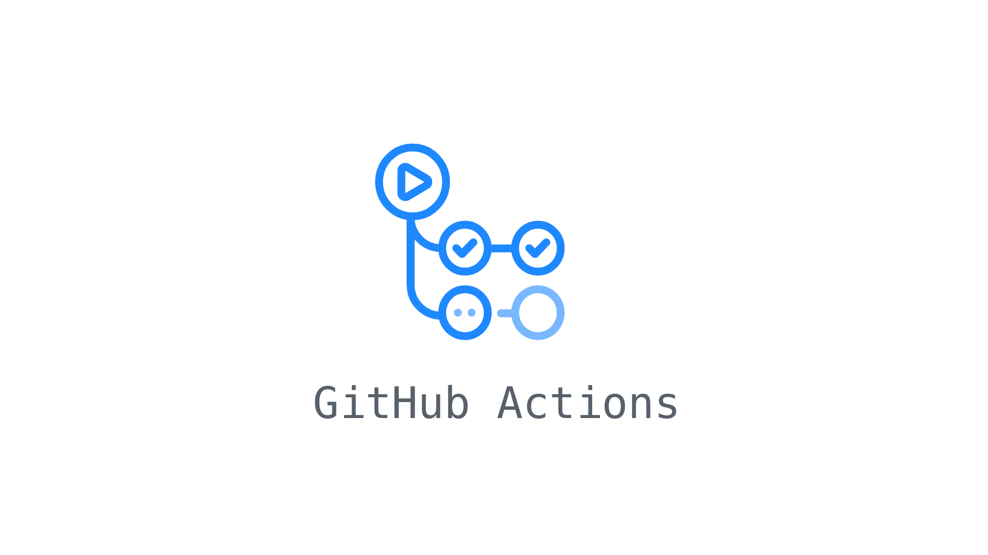
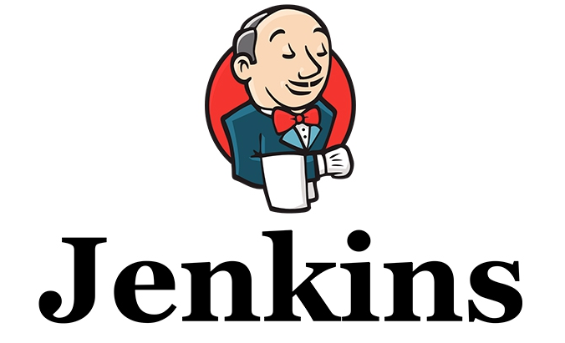


Tips for Choosing the Right CI/CD Tools
The choice of communication tools should be a balance of integration options with the preference of your team and the way that they work.
Pipeline issues should be easily and clearly presented within the tool.
Best practices are adopted because they work for almost everyone regardless of chosen process, which is why they should inform your tools selection.
Choose tool combinations that further the Infrastructure as Code (IAC) and Configuration as Code (CAC) advantages.
Robust and deep support is just as important a criterion as an intuitive UI to CI tool choice.
Testing tools are crucial to the CI pipeline, but a bad choice can slow the entire DevOps process.

Slide 11
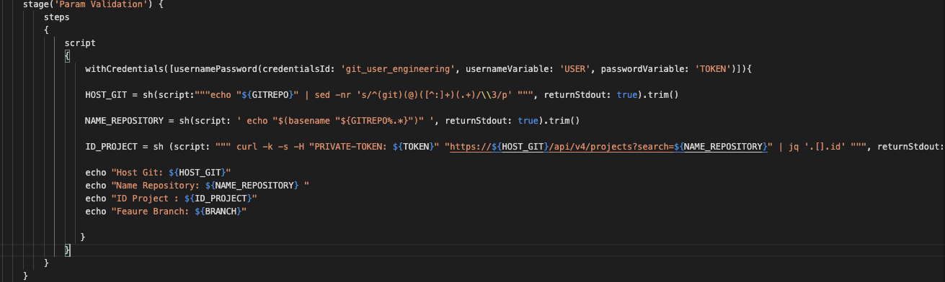
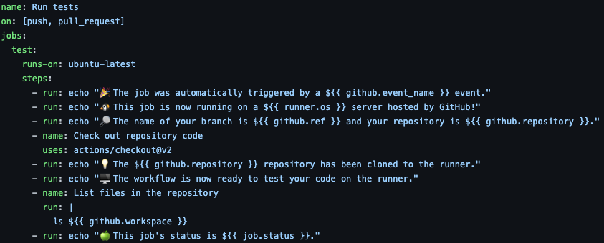
Param Validation
The validating String parameter plugins prevents users to enter invalid values.
The script (written in any language you want) will validate those parameters again, but this time called as a "Script Condition", to decide if a step should be executed or failed.

Slide 12
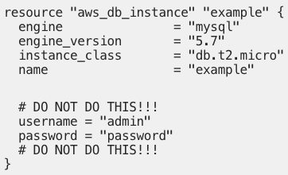
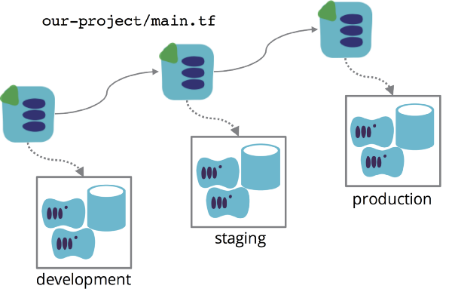



Configuration Deployment
It is important to have different environments to test the infrastructure. Each environment can have different kind of secrets.
Param Validation

Slide 13
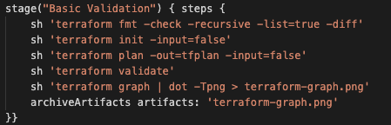
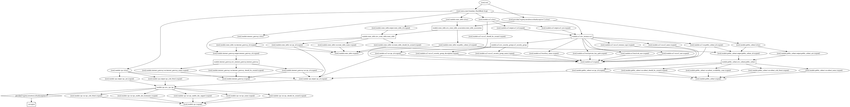


Static Analysis
Static Analysis
Configuration Deployment
Static Analysis is often performed during the Continous Integration (CI) process to generate a report of compliance issues which can be reviewed to receive an objective view of the code-base over time.
Param Validation

Slide 14
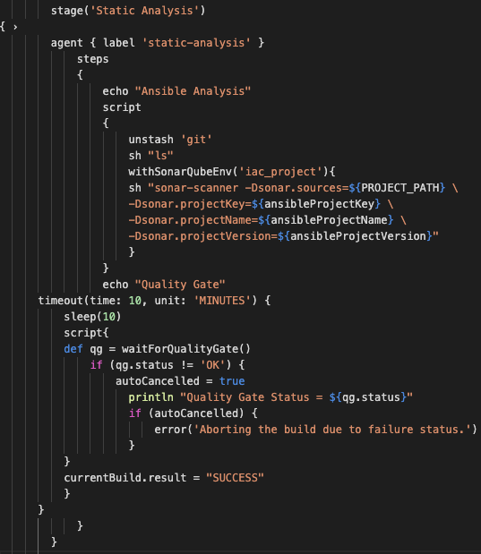
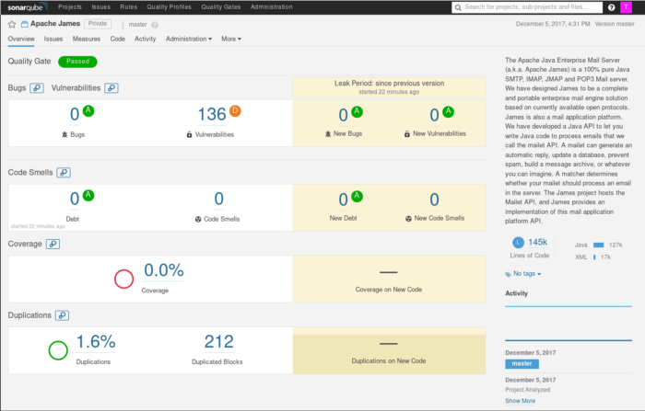
Static Analysis
Static Analysis
Configuration Deployment
The basic concept common to all Static Analysis tools is searching source code to identify specific coding patterns that have some sort of warning or information associated with them.
Param Validation

Slide 15
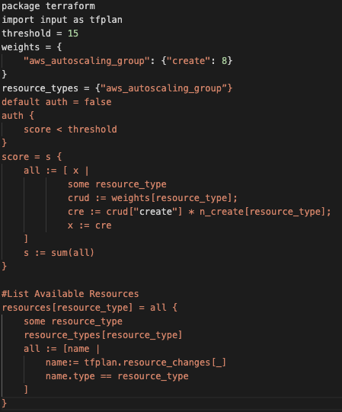
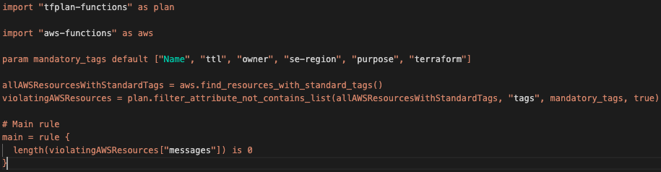

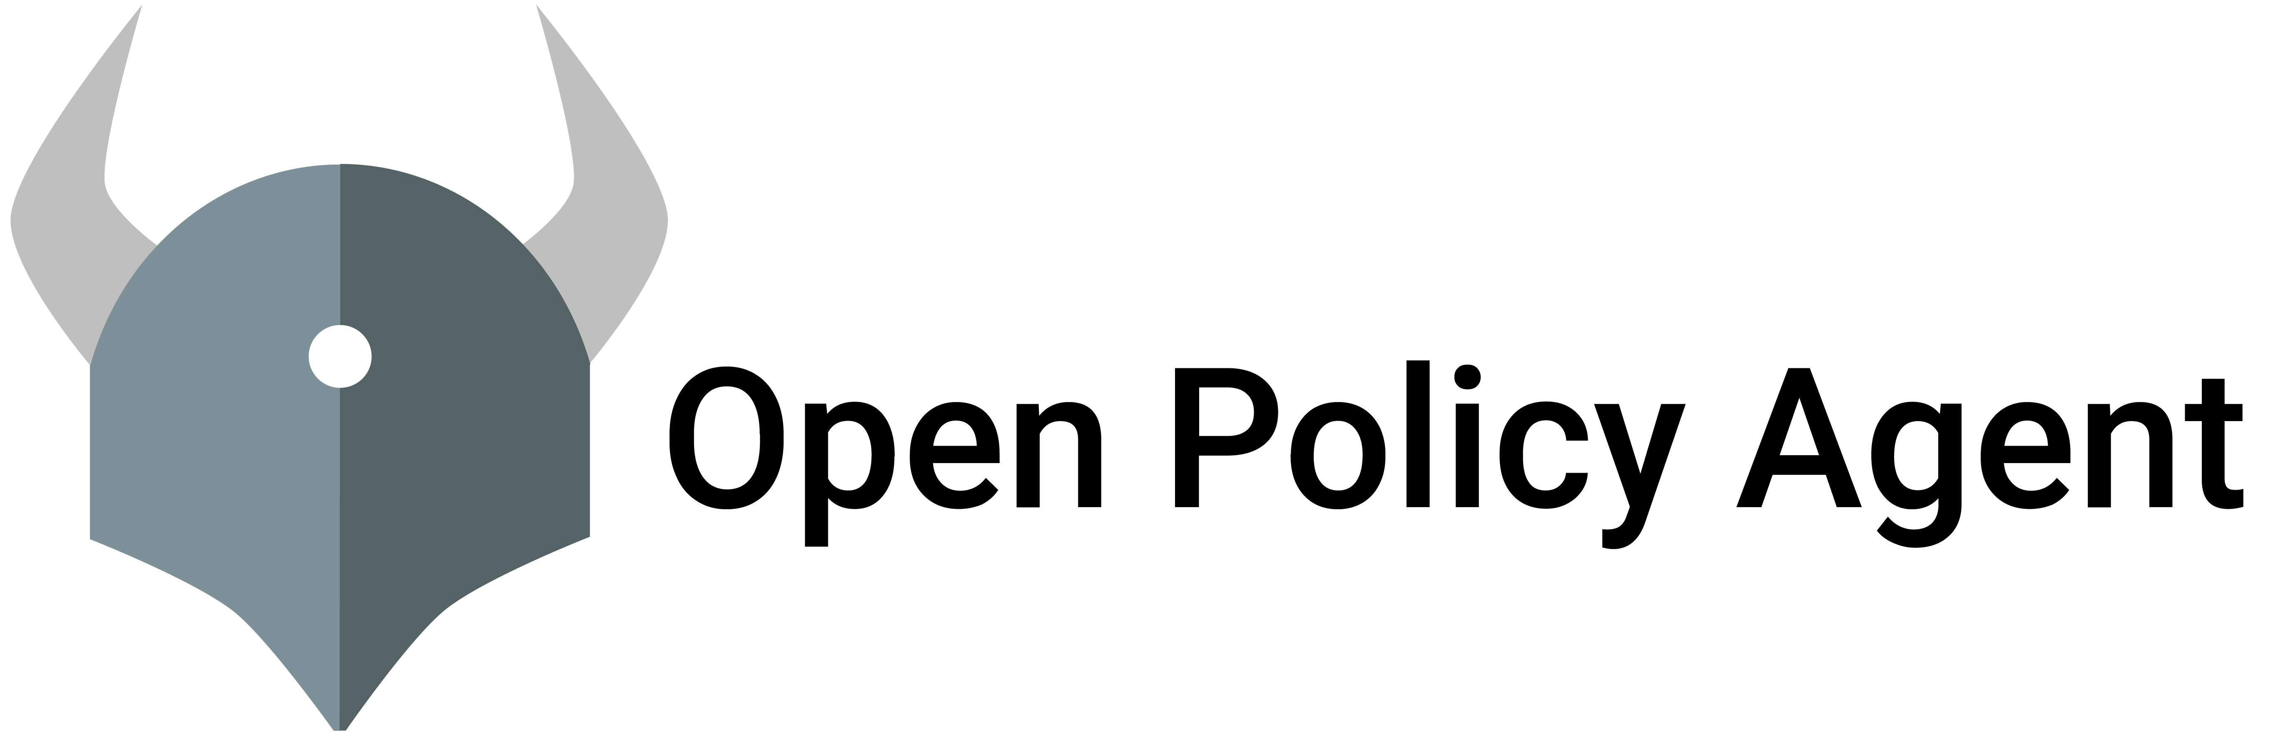
Policy check
Policy as Code is the writing code plan as a high-level language to manage and automate the policies. Similar to the concept of Infrastructure-as-Code (IaC), Policy-as-Code (PaC) is the concept of codification of your policies.
Types of Policies
Compliance Policies: Ensure compliance standards like PCI-DSS, SOC, or GDPR.
Security Policies: Internal Security Policies for security and infrastructure principles and data.
Operational Excellence: Policies for service interruption or degradation.
Static Analysis
Configuration Deployment
Param Validation

Slide 16
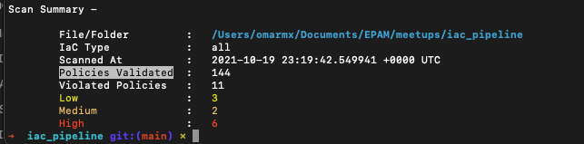
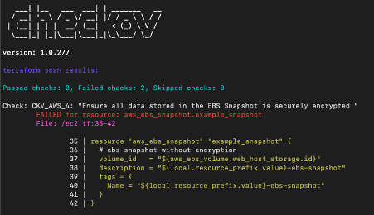
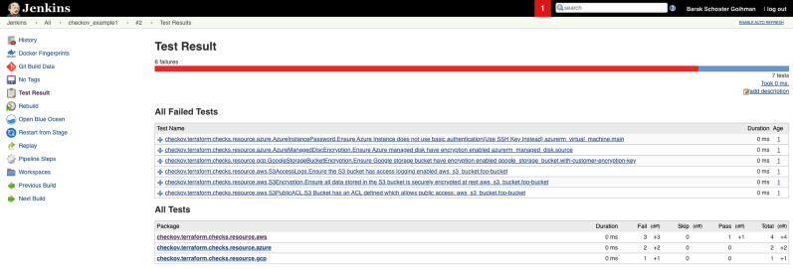
Policy check
Ensure all data stored in the RDS is not publicly accessible
Ensure no hardcoded AWS access key and secret key exists in EC2 user data
Ensure no security groups allow ingress from 0.0.0.0:0 to port 22
Ensure no hardcoded AWS access key and secret key exists in lambda environment
S3 Bucket has an ACL defined, which allows public READ access
Static Analysis
Configuration Deployment
Param Validation

Slide 17
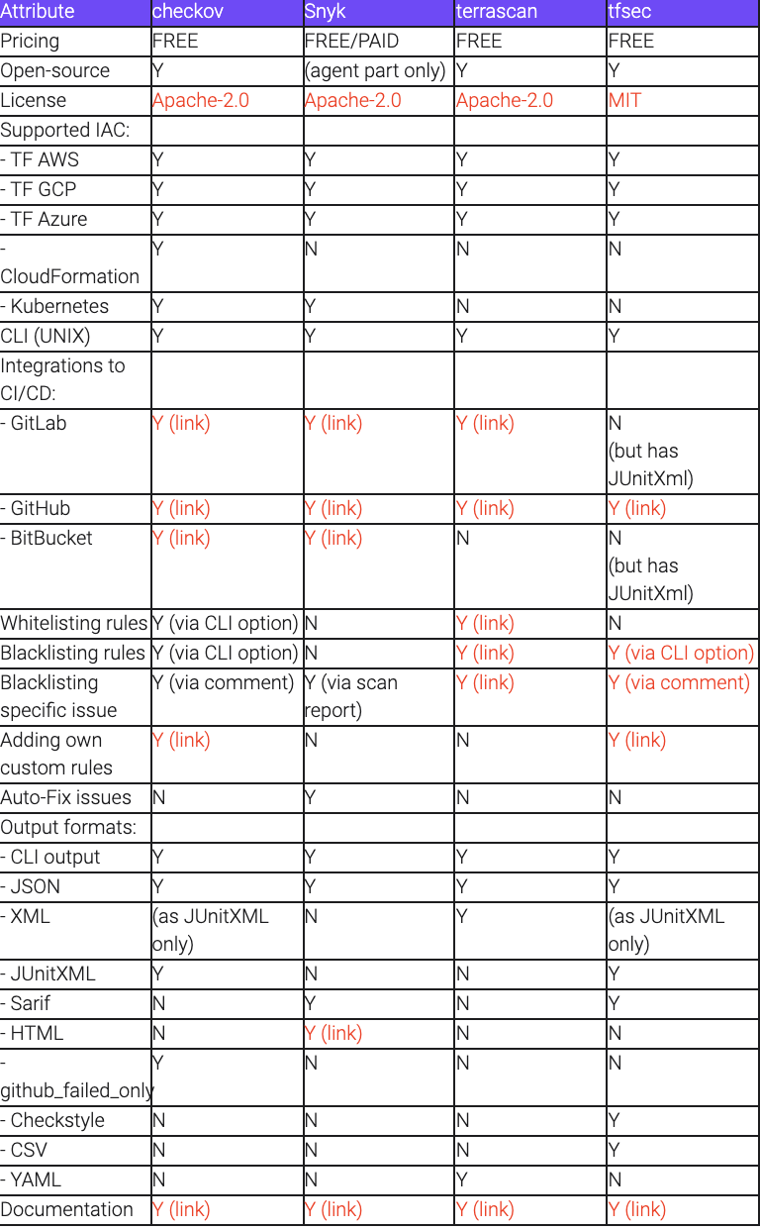
Feature set comparison
To start with the easier part we decided to gather the features of the compared tools based on our requirements and also add other ones that we thought could be interesting or useful. This was done by installing the tools, experimenting with them, checking their websites, code repositories, documentation, command line help, outputs, etc. The result of these efforts can be seen in the following table.

Slide 18
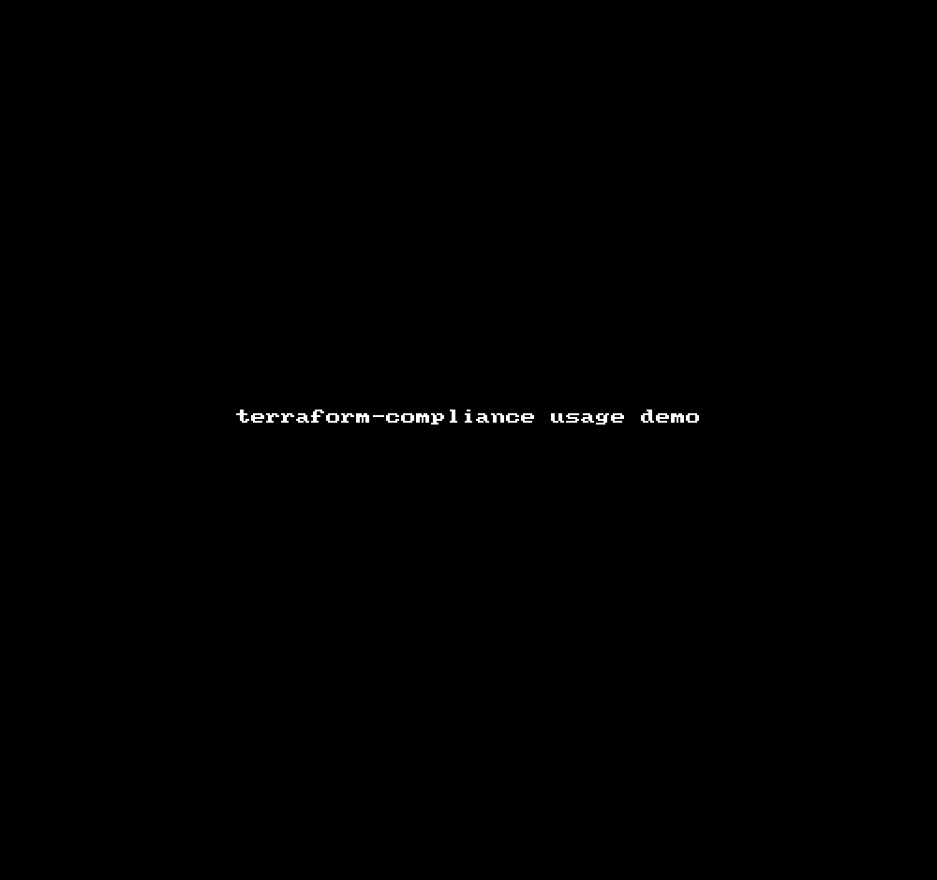
Policy check
Terraform-compliance is a lightweight, security and compliance focused test framework against terraform to enable negative testing capability for your infrastructure-as-code.
Static Analysis
Configuration Deployment
Param Validation

Slide 19
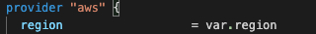
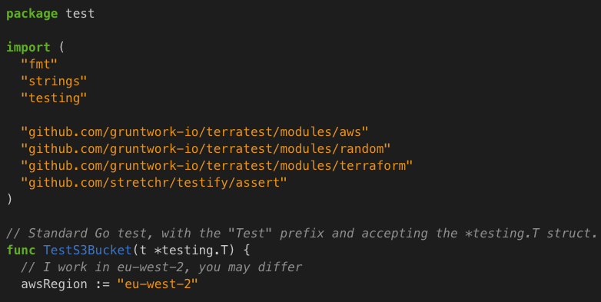
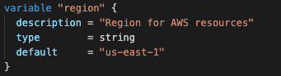

Unit Test
UNIT TESTING is a type of software testing where individual units or components of a software are tested. The purpose is to validate that each unit of the software code performs as expected. Unit Testing is done during the development (coding phase) of an application by the developers.
Test cases examples:
The resources will be deployed on the rigth location.
The reources will be deployed on the rigth subnet.
Policy Check
Static Analysis
Configuration Deployment
Param Validation

Slide 20
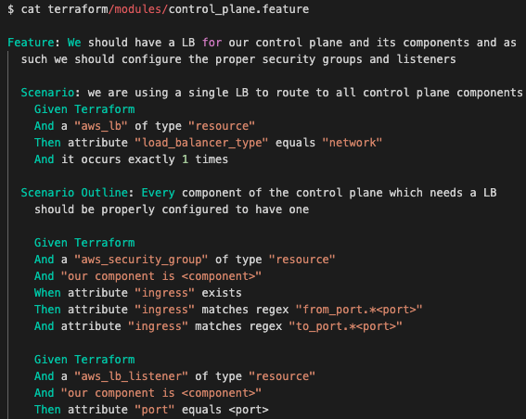
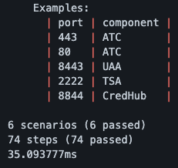

Unit Test
Clarity is a BDD(Behavior Driven Development) framework for Terraform. Clarity is a simple, single binary written in Go. Clarity uses *gherkin* as syntax. Clarity has its own set of matchers and HCL parser. Clarity has an extensive set of matchers like:
always equal
never equals
does not equal
is greater than
is less than
Exists
occurs (at least, at most, exactly) x times
Policy Check
Static Analysis
Configuration Deployment
Param Validation

Slide 21
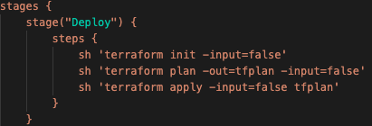
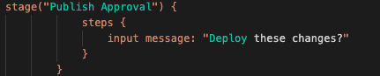
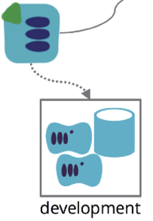
Deploy Infrastructure
The Deploy stage initializes Terraform, generates its plan but most importantly actually applies the changes for real. You would need to be certain you want to apply your Terraform code before this runs!
Policy Check
Static Analysis
Configuration Deployment
Param Validation

Slide 22

Peer Review (Development)
Contains a brief summary of the entire manuscript.
Clearly directs the editor on the path forward. Should this paper be accepted, rejected, or revised?
Identifies any major (internal inconsistencies, missing data, etc.) concerns, and clearly locates them within the document. Why do you think that the direction specified is correct? What were the issues you identified that led you to that decision?
Lists (if appropriate — i.e. if you are suggesting revision or acceptance) minor concerns to help the authors make the paper watertight (typographical errors, grammatical errors, missing references, unclear explanations of methodology, etc.).
Explain how the arguments can be better defended through analysis, experiments, etc.
Is reasonable within the original manuscript scope; does not suggest modifications that would require excessive time or expense, or that could instead be addressed by adjusting the manuscript’s claims.
Update MR/PR with Test results
Deploy Infrastructure
Policy Check
Static Analysis
Configuration Deployment
Param Validation

Slide 23
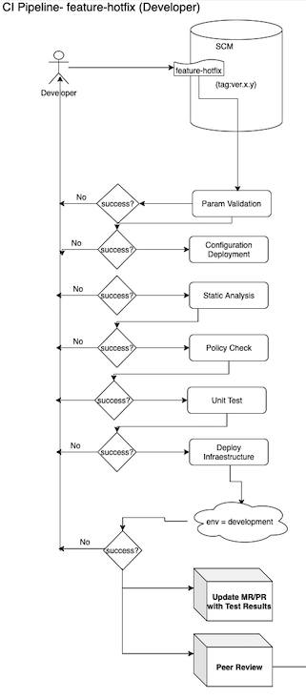
General Overview

Slide 24
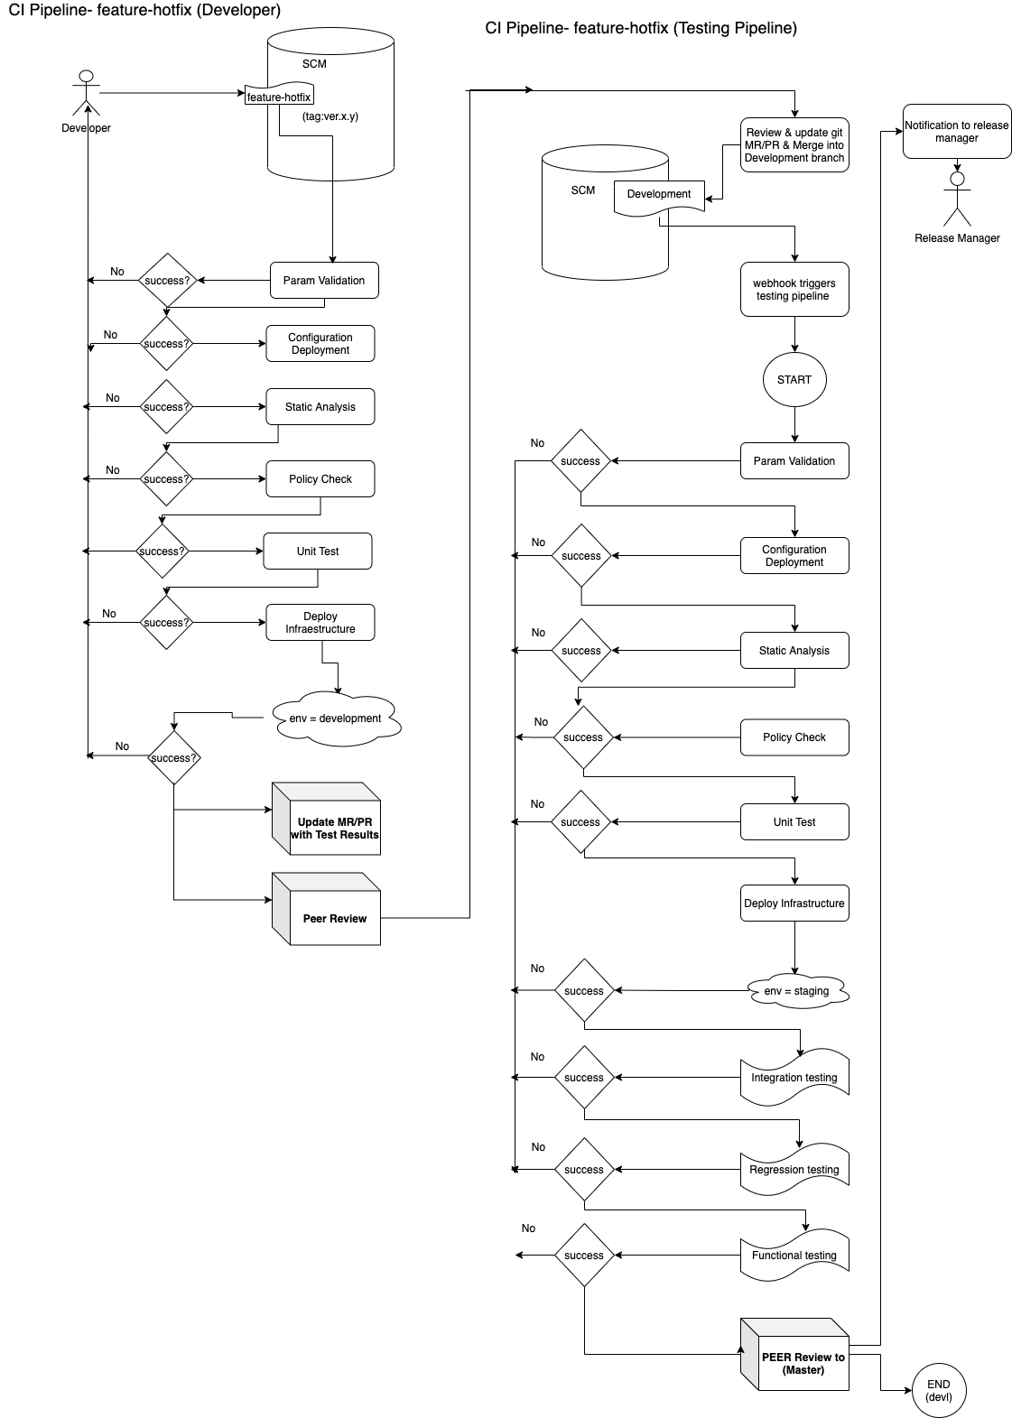
What are the next steps?

Slide 25
Six testing key strategies
Static testing of infrastructure as a code: Much the same as static testing of code, this implies composing tests to approve the nature of the foundation setup code. This should be possible utilizing compilers or style checkers to pursue pre-characterized norms around the design administration system.
Unit testing of infrastructure as code: The focal point of unit tests is to approve each bit of foundation code and ensure that particular conditions that every segment is in charge of are running. For instance, approving all the executable design definition records, for example, shell contents, Ansible playbooks, Chef formulas or Puppet shows to test each segment of the framework.
System integration testing: This includes testing the organization, of a conclusion to-end, ongoing conveyed framework into a creation like condition and running constant tests for execution, accessibility, and failover.
System testing: This alludes to running all the configuration files to set up the earth and test whether the application reacts to the incorporated setups overall. In an ongoing situation, it would mean testing if my server is running and the administrations that the server depends on, for example, OS, web server, database server, and so on are running effectively.
Blue/Green deployment: In the production environment is isolated into two sections; green, which is utilized for typical utilize, and the blue part, which runs the framework code changes. As each change is tried, it is taken off from the blue to the green condition. Utilizing checking apparatuses and instrumenting your frameworks are enter into this system to quantify the accomplishment of the organization.
Monitoring business in production: This refers to characterizing business-level KPIs and observing specialized KPIs in accordance with business KPIs.

Slide 26
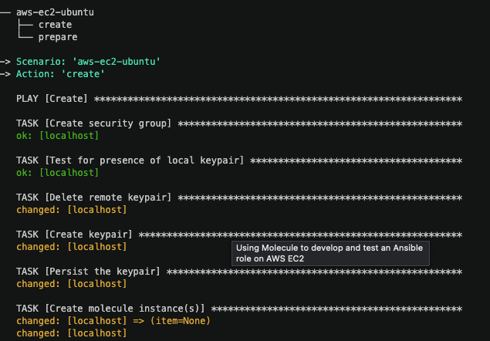
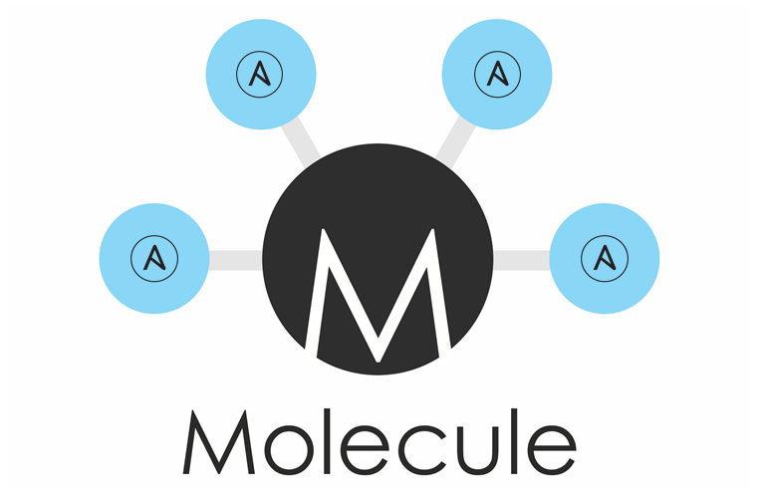
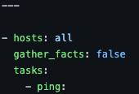
Integration testing
Integration testing is the second level of the software testing process comes after unit testing. In this testing, units or individual components of the software are tested in a group. The focus of the integration testing level is to expose defects at the time of interaction between integrated components or units.
Test cases examples
Icmp communication.
Internet communication.
Telnet to the port for the application running inside the instance.
DNS communication.

Slide 27
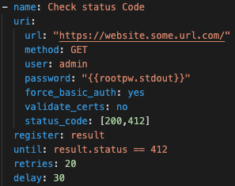
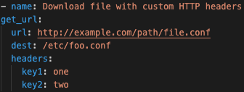
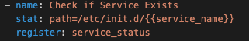
Functional testing
Functional correctness of the infrastructure.
Test cases examples:
Download file with custom HTTP headers.
Check if Service Exists
Check status code
Integration Testing

Slide 28
Functional testing
Functional correctness of the infrastructure.
Test cases examples:
Download file with custom HTTP headers.
Check if Service Exists
Check status code
Integration Testing

Slide 29
Regression testing
Regression testing is a software testing practice that ensures an application still functions as expected after any code changes, updates, or improvements.
Regression testing is responsible for the overall stability and functionality of the existing features. Whenever a new modification is added to the code, regression testing is applied to guarantee that after each update, the system stays sustainable under continuous improvements.
When to apply regression testing
Typically, regression testing is applied under these circumstances:
A new requirement is added to an existing feature
A new feature or functionality is added
The codebase is fixed to solve defects
The source code is optimized to improve performance
Patch fixes are added
Changes in configuration
Fuctional testing
Integration Testing

Slide 30
What are the next steps?

Slide 31
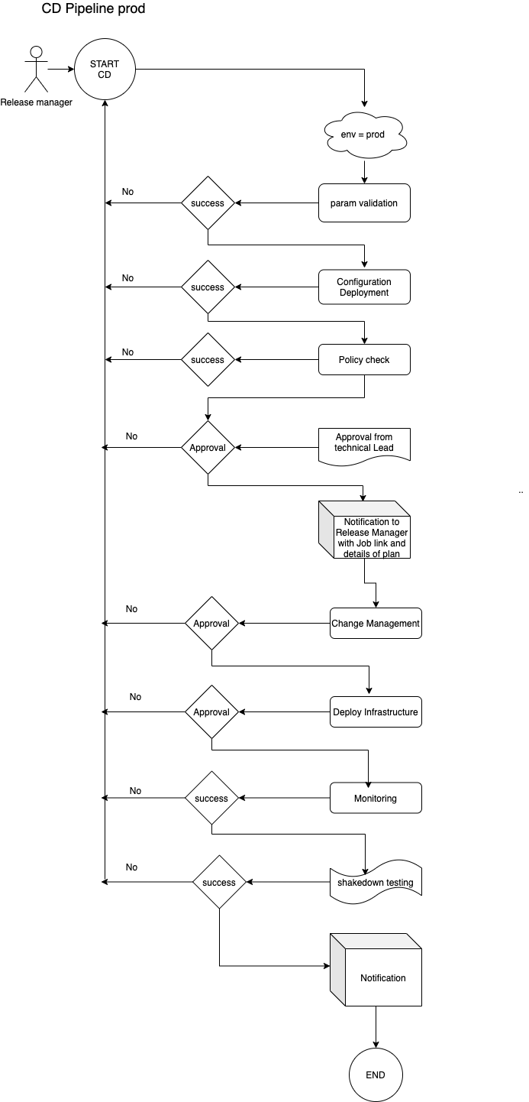
Deploy to production

Slide 32
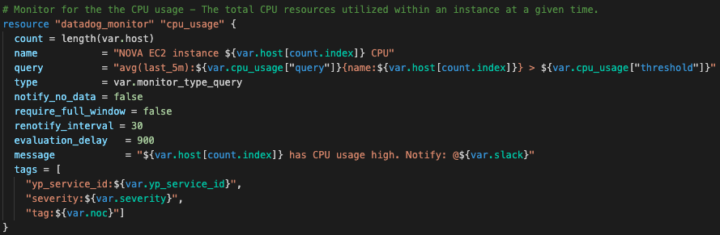
Monitoring
Monitoring as code is not just automated installation and configuration of agents, plugins, and exporters — it encompasses the entire observability lifecycle, including automated diagnosis, alerting and incident management, and even automated remediation.

Slide 33
Conclusion
Now you understand what a devops pipeline is and how it can help speed up your infrastructure development life cycle.
The DevOps pipeline is a broad subject, and every organization will have its way of integrating one into their workflows. The ultimate goal is to create a repeatable system that takes advantage of automation and enables continuous improvements to help deliver high-quality infrastructure faster and easier.

